Slide 1
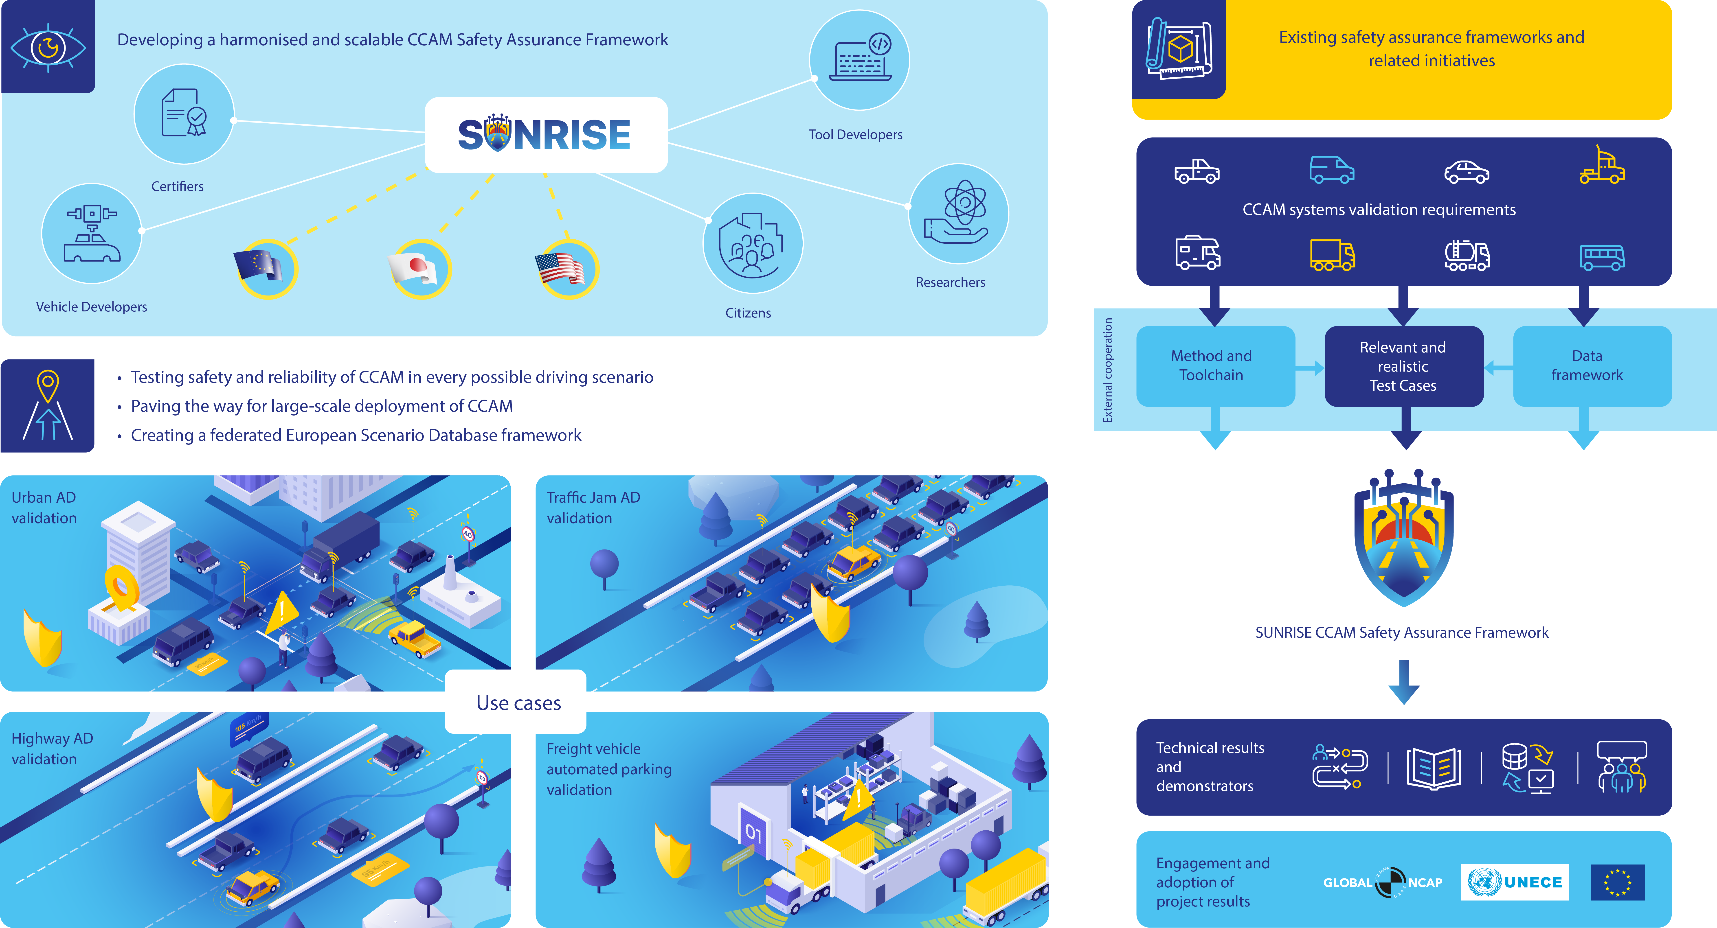
Contacts:
  Name, company, email (optional)
  General email: info@ccam-sunrise-project.eu
  Project Coordinator: Stefan de Vries (IDIADA)
  stefan.devries@idiada.com

